Slide 1
Keep me hidden (1 of 2)
This hidden slide contains a high-level overview of essential information about the workshop. See the leader guide for more details.
To run this workshop successfully
Setup and materials
Review the facilitator guide. This guide provides an overview, detailed prep instructions, a timed outline of the workshop, and step-by-step demo instructions with annotated screenshots.
Revise or hide placeholder slides [1 and 2].
Post a link to the digital participant guide. The participant guide has a digital worksheet so participants may follow along with the facilitator. It also has links to more learning resources.
Per Microsoft accessibility standards, use the Subtitles feature in PowerPoint to caption your presentation in real time.
***CST Session Notes are on slides #8 and 10. Slide 10, facilitator will send a sample document to the participants to use Immersive Reader and to practice dictation.
Type | Details
Hardware | Leader: Surface Pro Surface Pen Screen display and connecting cables Participants: Surface Pro Type Cover Surface Pen
Software | Leader’s presentation device only: Access to Microsoft Teams for Education and the PowerPoint All devices: Access to the internet and Microsoft Teams
Materials | Leader preparation video PowerPoint presentation Leader guide Participant guide Pre-made Forms for Assignment Any link for the course evaluation

Slide 2
Keep me hidden (2 of 2)
This hidden slide contains a high-level overview of essential information about the workshop. See the leader guide for more details.
Required live demonstrations
To deliver this workshop, you must be able to successfully demo the following tools and features. Step-by-step instructions for these simple, quick demos are detailed in the leader guide’s demonstration instructions section and included in the relevant slide notes. Resource links are provided here for your convenience to support your preparation:
Immersive Reader
Dictation
PowerPoint Live
PowerPoint Designer
OneNote
See the Facilitator’s Guide pages 6 – 10 for step by step demonstrations. ***CST Session Notes are on slides 10 and 12. Slide 12, facilitator will send a shared document to the participants to practice the dictation skill. On slides 9 and 10 facilitator will have participants work in PowerPoint to show QuickStart function and Design functions.

Slide 3

Introducing Microsoft 365 Features to Support Remote and Hybrid Learning
Educator Insider Series:
Facilitated Learning Workshops
Notes:
Say: Hi everyone, thanks for joining us! My name is __________. I will be your trainer today. Let’s take a quick pause in our day to be mindful of our day so far. Please click on the link to the poll in Microsoft Forms to share anonymously the emotion you feel right now: Excited, Happy, Calm, Overwhelmed, or Frustrated.
​​ (After the poll)​​ ​​ Thank you for your responses. Many of you feel _________ right now. I will be mindful of this poll as we are working together today. (**Review Note in "DO" section)​​
​​
Do: As participants arrive, confirm that all registration paperwork has been completed and that each participant has checked in and provided an email address. ​ ​Link to poll: http://aka.ms/howareyoufeeling ​ ​​ Have participants fill out the Microsoft Forms Poll Activity: How are you feeling today? Poll answers: Excited, Happy, Calm, Overwhelmed, Frustrated. Wait for responses and honor how participants feel. ​​
**Note** Review answers from the poll with grace and compassion, especially if people are overwhelmingly indicating that they are stressed, tense, "down", tired, etc. Express that the goal of the workshop is to alleviate stress. If they indicate overwhelming joy, awesome. Say we intend to make their day even BETTER!​​

Slide 4


Overview
How can Microsoft 365 applications help students, educators and parents work together?
Microsoft 365 applications
PowerPoint Expanded
Word Enhanced
OneNote
Notes:
Say: In our workshop today we will discuss how Microsoft 365 applications can help students, educators and parents work together. The goal of this workshop is to: Demonstrate different creative features of PowerPoint, Word, and OneNote that support students in many different areas of learning whether it is in person, online or hybrid. I am excited to show you many of the tools that Microsoft 365 has available for students.
Do: Reinforce the essential question and explain what is available in Microsoft 365.
Show the following video https://www.youtube.com/watch?v=c7_3_MukBjQ&feature=youtu.be

Slide 5

Learning Objectives
Applications
PowerPoint and Word
OneNote
Notes:
Say: Microsoft 365 helps students achieve more by allowing them to work and collaborative from anywhere. This workshop is an overview of the products included in 365. I will also show you some of the amazing new features of PowerPoint, Word and OneNote.
Today I will: 1. Show you applications that are a part of Microsoft 365 and how these applications make work more efficient.
2. Show you features of PowerPoint such as PowerPoint Live and PowerPoint Designer and features of Word such as Immersive Reader and Enhanced Dictation.
3. Lastly, I will show you Microsoft OneNote and give examples of the type of work students can do in it.
Do: Each square reveals a learning objective.

Slide 6


Applications
Notes:
Say: It is incredibly important to be able to access learning material at any time from any device especially now. Microsoft 365 makes this incredibly easy to do. Microsoft tools support learners of all ages and abilities. With a Microsoft 365 account students can log into their school accounts at Office.com where they can access Microsoft Teams, Word, PowerPoint and other applications from their web browser. It couldn’t get any easier.
Do: Reinforce that it is easy to access Microsoft 365 from anywhere.

Slide 7

Demonstration
Navigating Microsoft 365
Waffle
Notes:
Say: Finding applications in Microsoft 365 couldn’t be easier. The Microsoft 365 app launcher allows you to quickly find the applications that we all love and use. The waffle also make opening and switching between apps super easy by showing the apps that you most recently used. Let me show you how to easily navigate the world of Microsoft 365. Within Microsoft 365 are applications that help students do presentations like PowerPoint or Sway. Write a paper with Word. Attend class using Teams and take notes in class with their OneNote Class Notebook.
Do: Demonstration 1: How to navigate and find the applications in Microsoft 365.

Slide 8
PowerPoint Expanded
Notes:
Say: PowerPoint is an application that allows you to give presentations and tell a story through slides. But today, it’s become much more than that. For those who have used it before, PowerPoint in the year 2020 is not the same PowerPoint from ten years ago. The features available now are miles ahead of where they were then. No longer is PowerPoint simply bulleted lists and pictures on each slide. We have the ability to really create fun and creative presentations that will capture the attention of students.
Chat box: Now let’s answer a question in the Chat box. When you think about an hour-long PowerPoint presentation what is the first thing that comes to mind?
Do: Share the PPT slide. Share the chat and respond to participants.

Slide 9
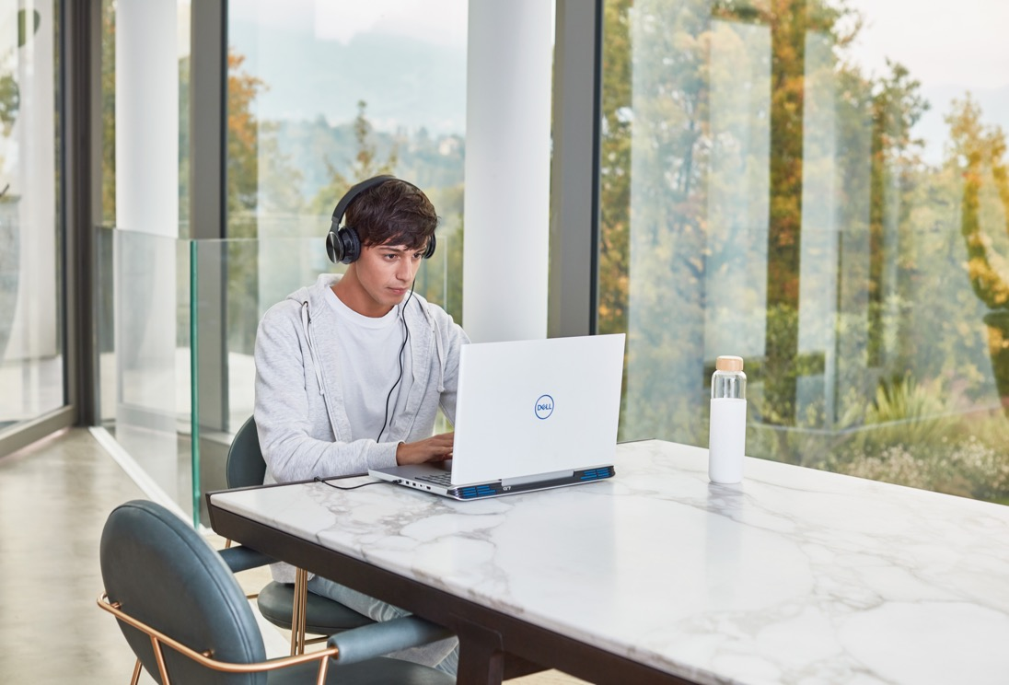
Demonstration
PowerPoint Live
Notes:
Say: Did you know that PowerPoint can now translate the language of the presenter in real time. This feature is called PowerPoint Live and the language can be automatically translated into over 60 languages. This can definitely be helpful for English Language Learners. Let’s see how this works.
Do: Share your screen and demonstrate how to use PowerPoint Live. (These steps are also in the Facilitator guide.)
Step 1: Since you are presenting using Microsoft Teams you will need to use screen sharing mode rather than presentation sharing mode. State to the audience that if they would like to see the feature in action then they may need to use a separate device which will allow the primary device to be dedicated to the presentation itself.
Step 2: To get started with Live Presentations open your slide deck in PowerPoint for the web and go to the Slide Show tab. First, check your audience setting. Click the drop arrow next to Present Live to select who should be able to connect to this presentation. Depending on who you are presenting to you can either select Only people in your organization or Anyone.
Step 3: select Present Live and your presentation will begin with a screen that shows a customized QR code. You can also start your Live presentation from the slideshow toolbar. Explain that the audience can point their device cameras at the QR code, tap the link that appears over the QR code and then PowerPoint Live will load the presentation into their web browsers.
Step 4: Explain that once the presentation is loaded then they will see your spoken words transcribed on the screen in near real-time. If an audience member would like to have your words translated for them into a different language, they can tap the language indicator and select from one of more than 60 other languages. Once they've selected their language your spoken words will be machine translated into that language, and shown to them on their device as subtitles.
Step 5: If someone wants to give you feedback as you go they can tap the feedback button (which looks like a smiley face) towards the bottom right of their device screen. There they can select from a handful of different feedback types, from "like" to "puzzled" and more. Their selection will briefly appear on the presentation screen.

Slide 10

Demonstration
PowerPoint Designer
Notes:
Say: When students have presentations they shouldn’t have to think about where the words and pictures go. PowerPoint along with artificial intelligence makes it super easy for students to create engaging presentations that will certainly impress their classmates and teachers.
Do: Demonstrate how to use PowerPoint Designer. (These steps are also in the Facilitator guide.)
Step 1: Using a preloaded PowerPoint demonstrate how to use PowerPoint Designer. Explain to the audience that they can ask for design ideas any time by choosing Design > Design Ideas on the ribbon.
Step 2: Explain that this is an additional feature for subscribers. The first time you try out PowerPoint Designer, it asks your permission to get design ideas for you. If you want to use Designer, select Turn on or Let's go. Once you've turned on intelligent services, PowerPoint automatically shows you design ideas when you add photos to your slides.
Step 3: Scroll through the suggestions in the Design Ideas pane on the right side of the window. Click to select the design you want, or else close the window. Explain that if you select one of the ideas, your slide is changed accordingly. You can also select another idea from the pane or go back to your original slide design: Press ⌘+Z to undo a design change you've just selected. You can ask for design ideas any time by choosing Design > Design Ideas on the ribbon.
Step 4: PowerPoint Designer gives the user suggestions Professional Layouts, SmartArt graphics, Illustrations .
***CST Notes: Have the participants actually set up their own slideshow in PPT Designer

Slide 11

Word Enhanced
Notes:
Say: Word is everyone’s favorite tool for writing papers. I think that once you see the following features and how easy they are to use you will be wowed. These tools are great for parents, educators and students.
Do: Show the slide.

Slide 12

Demonstration
Immersive Reader
Enhanced Dictation
Notes:
Say: Now let's have a look at some incredibly cool features that you can use with Word Online. The first is Immersive Reader which provides support through text to speech. Watch as I demonstrate this feature.
Do: Show the audience how to use Immersive Reader in Word Online.
Step 1: Open the preloaded document. When you have the document open, select View and then Immersive Reader.
Step 2: Demonstrate using the sample text in the preloaded document that you can have the text read aloud to you or you can also select individual words to be pronounced in English or in any of the languages included.
Say: Now I am going to show you how to write without even touching the keyboard. This is a game changer that can help students save time.
Do: Show the audience how to use Dictation in Word Online.
Step 1: Open a blank document. Go to Home > Dictate.
Step 2: When the mic icon appears make sure that the participants know to wait for it to turn on to be sure it has started listening.
Step 3: Demonstrate Dictation by saying the following sentences or sentences of your choice. “I like going to the market so that I can find all kinds of foods! Would you like to go to the market with me?” You can use these sentences to demonstrate how to include punctuation marks. You include them by actual saying the name i.e. exclamation mark.
CST Notes: Have the participants work with Immersive Reader with a sample document and have them dictate in Word.

Slide 13
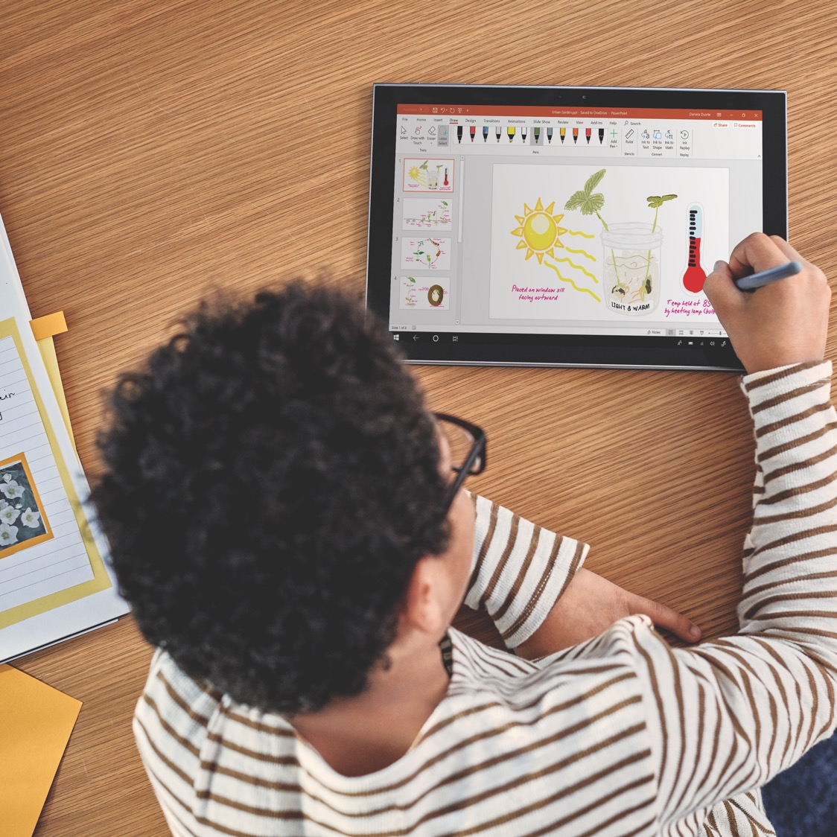
Microsoft Whiteboard
What do you think about the tools that we have talked about so far? Draw any emoji to show what you are thinking.
Notes:
Say: Now let’s move on the the next topic. Have a look at the whiteboard on your screen. What do you think about the tools that we have talked about so far? Draw any emoji that shows how you are feeling.
Do: Interact with the participants as the answers come in.

Slide 14
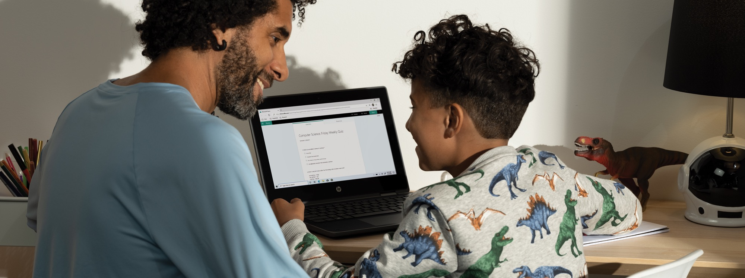
OneNote Class Notebook
Notes:
Say: OneNote is a really cool digital notebook which allows students to create, take handwritten notes, and easily access their notes from anywhere. Now I am going to show you some actual OneNote pages that will demonstrate how useful this tool is for educators and students. I think that once you see this in use you won’t want to go back to the old way of taking notes ever again.
Do: Show the PPT slide.

Slide 15

Demonstration
Digital Notebook
Notes:
Say: OneNote is set up just like a real live notebook which can help students to feel comfortable with using it. This application is incredible for helping students to stay organized. Students are able to type, sketch, write by hand, record audio notes and even include videos. OneNote also allows students to share their notebooks with classmates. They can even take notes together. You couldn’t ask for a more useful tool. Let me show you how to use a few of the features.
Do: Demonstrate how to set up a notebook, makes notes and upload a picture.
Say: Check this feature out. OneNote allows you to write or type any math problem and Math Assistant will help you to solve it quickly while giving step-by-step instructions that help you learn how to solve it.
Do: Share the following video with the participants.
https://support.microsoft.com/en-us/office/solve-math-equations-with-math-assistant-in-onenote-1b37bb8d-ecd1-40d7-8d0f-5e6e46547441
Say: As you can see there are an incredible number of features that OneNote can provide to simplify learning.

Slide 16
Join us for more
Discover more free workshops at microsoft.com/store/events, including programs for students, businesses, and educators.
Notes:
Say: Remember that Microsoft is constantly developing products to give all students access to their learning goals. Microsoft not only wants to give access, but completely remove barriers within education. Please take the survey about the workshop. I have shared the link with you in Forms which is another app that teachers may use during class meetings. It can be used to take polls, assess student well-being, and for quick assessments.
Do: Remind participants that Microsoft offers many solutions for students with various learning needs. Have the participants take the forms poll.

Slide 17
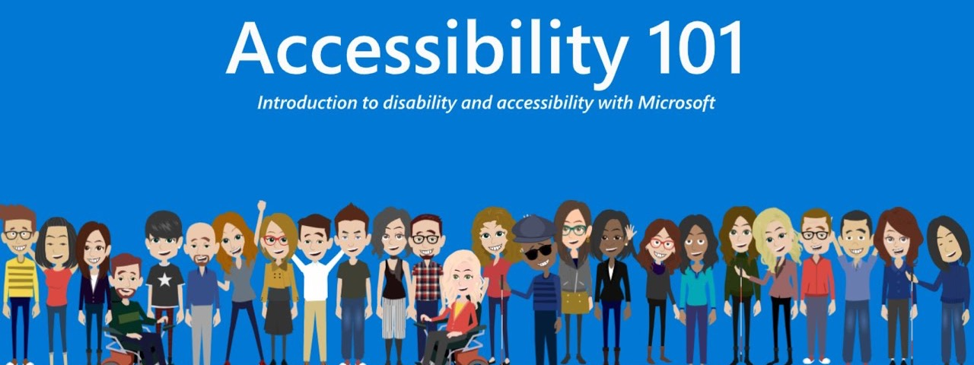
Thank you!
Notes:
Say: Do you have any questions about what we’ve discussed today?
Do: Encourage participants to stick around to ask questions.

